Slide 1



Demand Forecasting
Author Name: Arkaprova Saha
Date: 7th Jan 2023

Slide 2

Problem Statement
The Client is a multi-city meal delivery service. It has various fulfillment centers which each keep an inventory of items.
The task is to design a model capable of forecasting the demand of various meals in various centers in order to keep an adequate inventory of items so as not let items go stale and keep up with the demand at the same time.

Slide 3
AGENDA
EDA
Time Series Models
Regression Models
More Granular Models
Results and Prediction
Further Work

Slide 4
Exploratory Data Analysis

Slide 5
Data Description
Fulfillment Center Data
Weekly Demand Data
Variable | Deﬁnition
center_id | Unique ID for center
city_code | Unique code for city
region_code | Unique code for region
center_type | Anonymized center typ
op_area | Area of operation
Variable | Definition
id | Unique ID
week | Week No
center_id | Unique ID for fulfillment center
meal_id | Unique ID for Meal
checkout_price | Final price incl. all
base_price | Base price of the meal
emailer_for_promotion | Emailer sent for promotion of meal
homepage_featured | Meal featured at homepage
num_orders | (Target) Orders Count
Meal Info Data
meal_id | Unique ID for meal
Category | Type of Meal (Snack..)
Cuisine | Meal Cuisine (Indian,..)

Slide 6
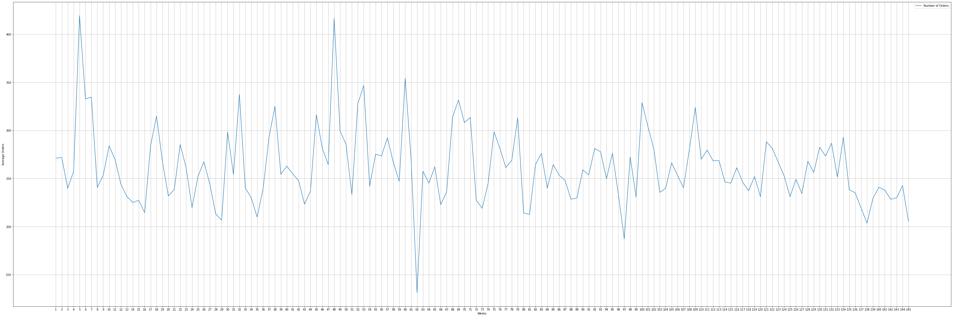
Trend average Orders per week

Slide 7
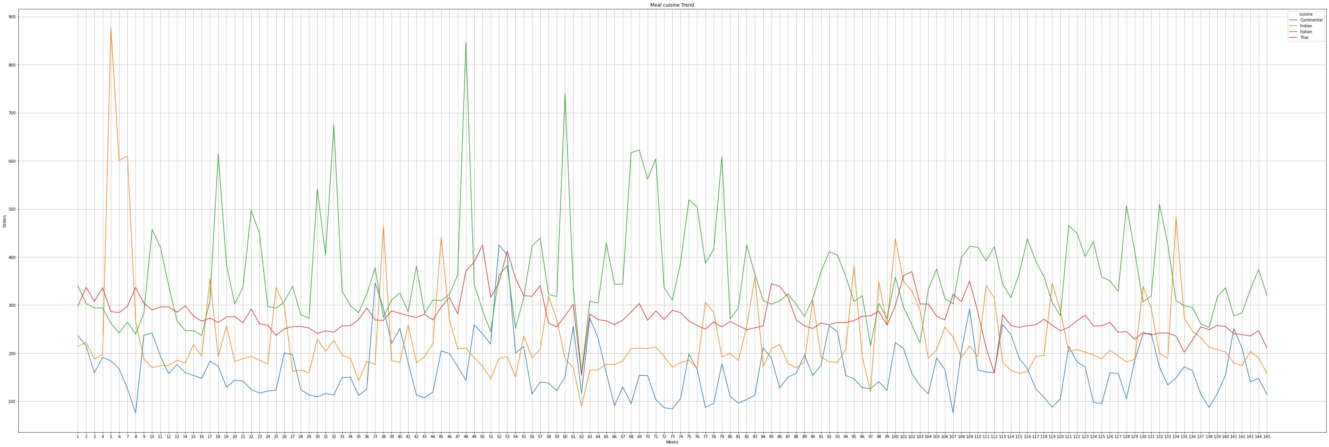
Trend according to different categories
Meal cuisine wise trend

Slide 8
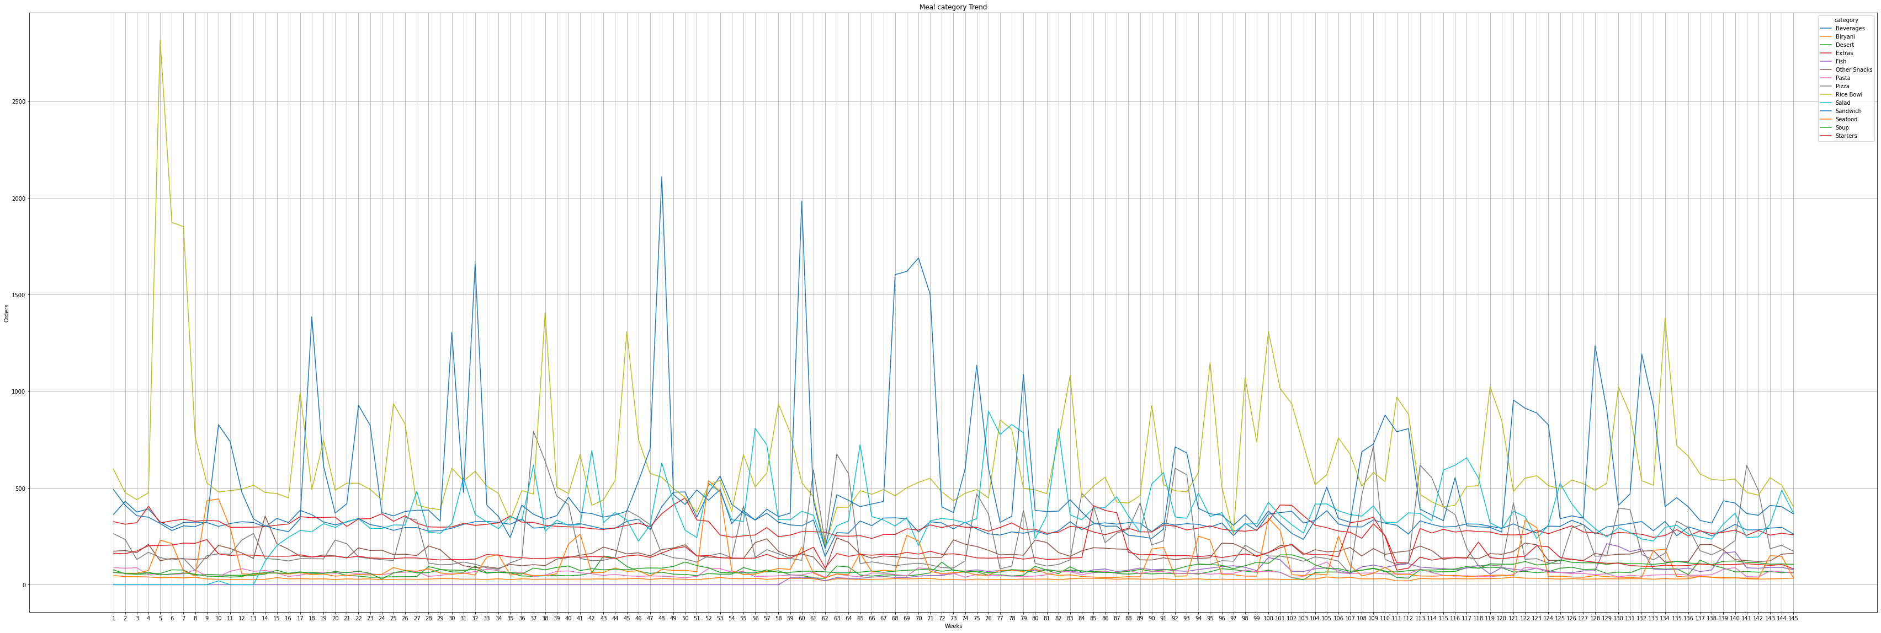
Trend according to different categories
Meal Category Wise trend

Slide 9
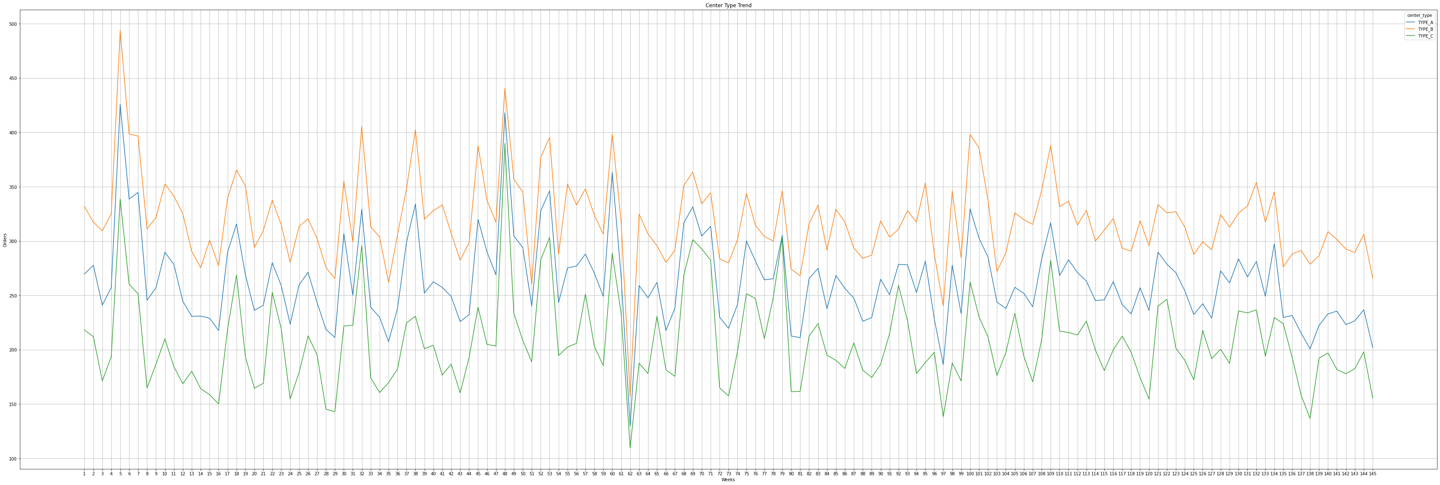
Trend according to different categories
Center Wise Trend

Slide 10
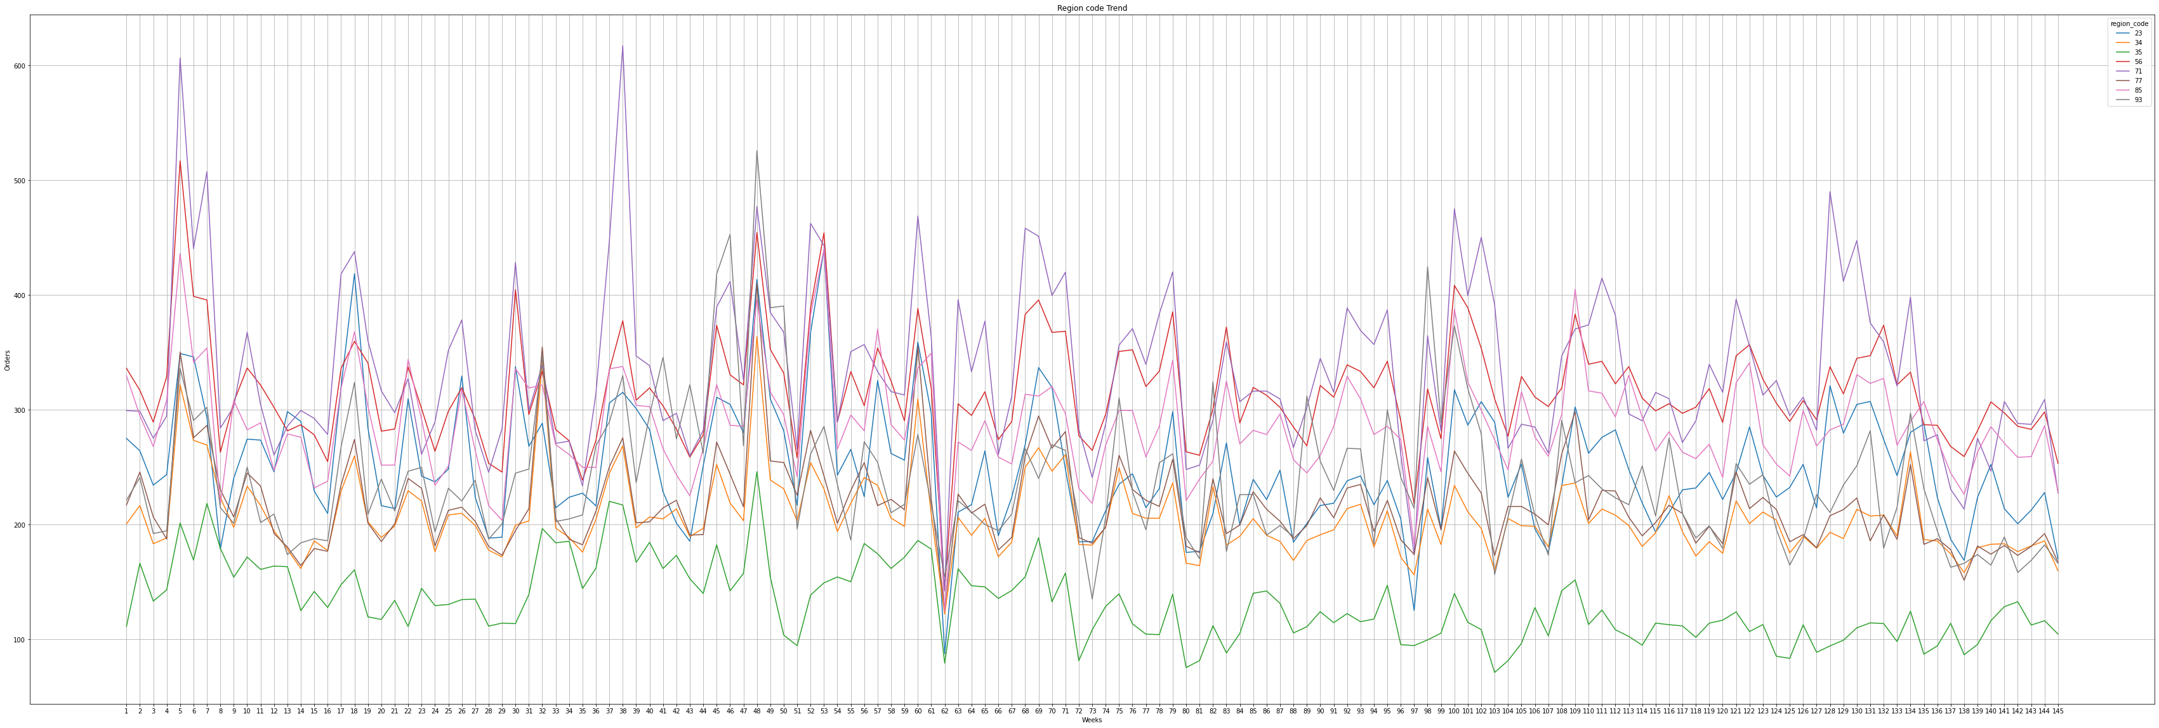
Trend according to different categories
Region Wise Trend

Slide 11
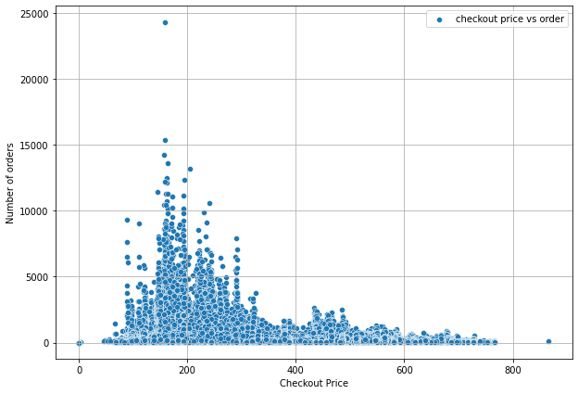
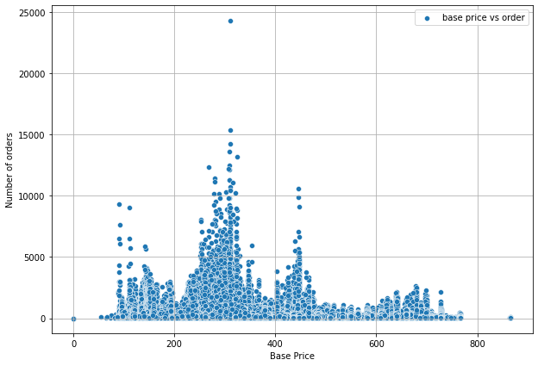
Price v/s Number of Orders
Checkout Price vs Number of Orders
Base Price vs Number of Orders

Slide 12
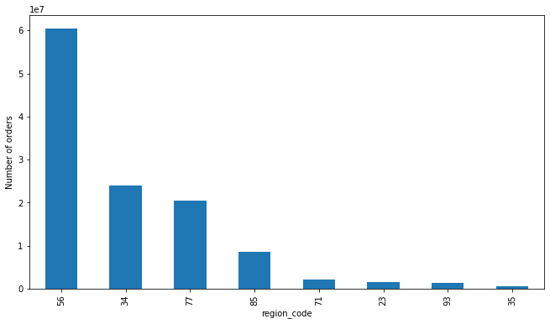
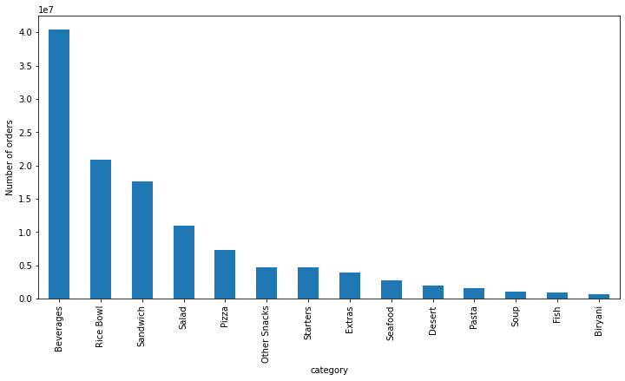
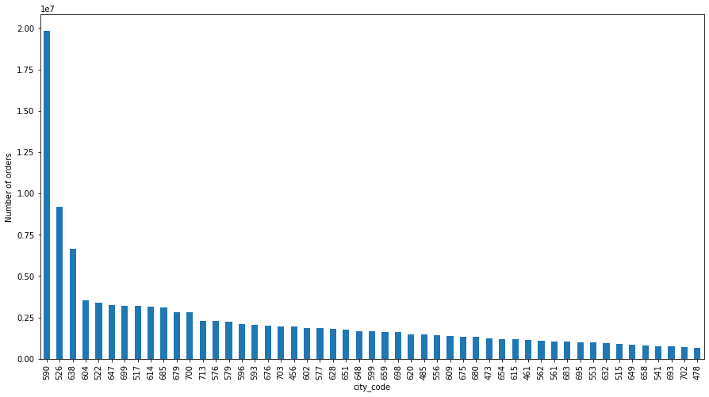
Visualization of orders, among region, meal catagory
Region wise total number of orders
Category wise number of orders
City wise total number of orders

Slide 13
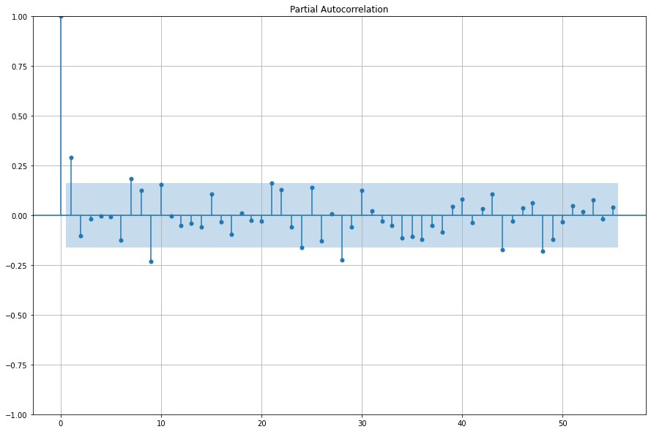
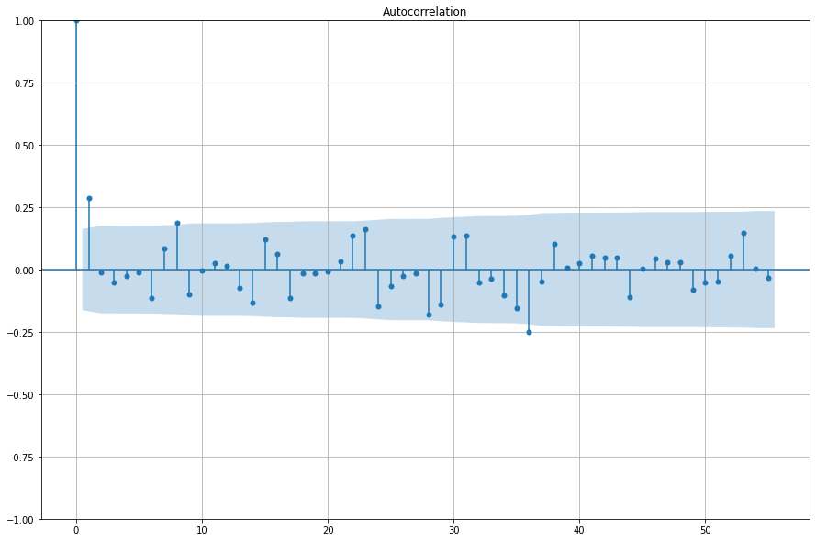
Checking Stationarity
PACF Plot
ACF Plot
Note from the ACF and PACF plot that there are no consecutive peaks after 1, indicating there is no severe non-stationarity

Slide 14
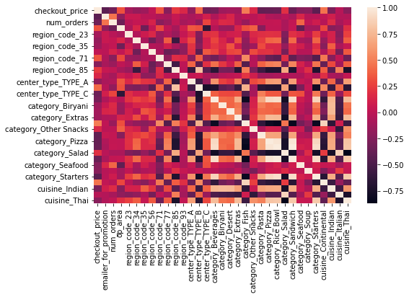
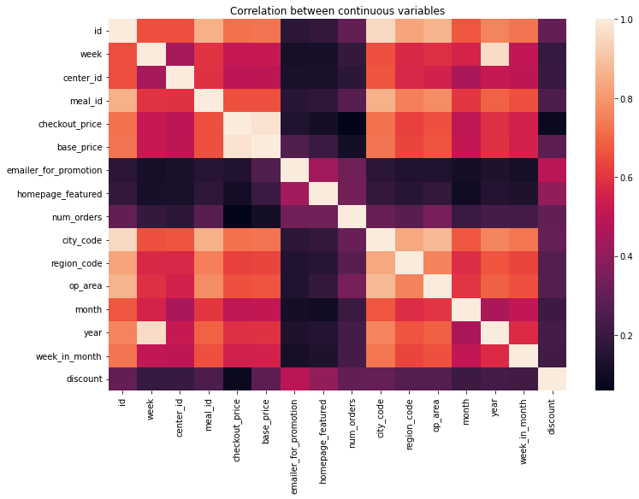
Correlation b/w Regressors
Heatmap for variables
Heatmap after applying dummy variables
Note from the ACF and PACF plot that there are no consecutive peaks after 1, indicating there is no severe non-stationarity

Slide 15
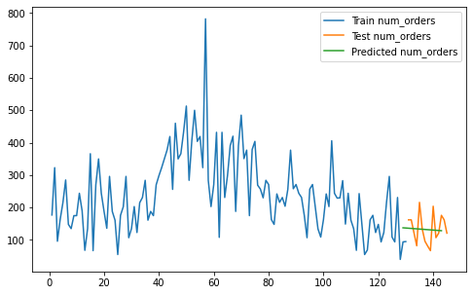
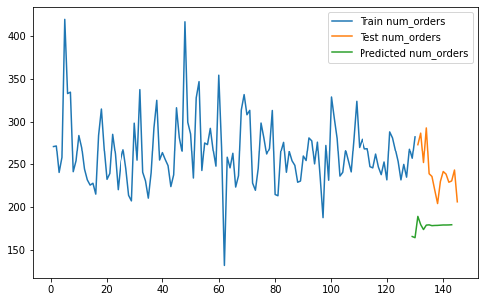

Time Series Models on weekly aggregated data
Index | TS Model | R² | MAPE
1 | Vector ARIMA | -0.001 | 30.99
2 | VARMAX (Using Exogenous Variables) | -6.706 | 25.70
3 | VARMAX (Using Exogenous Variables and dropping regressors with high correlation) | -5.67 | 23.47
Model 1
Model 2
Model 2

Slide 16
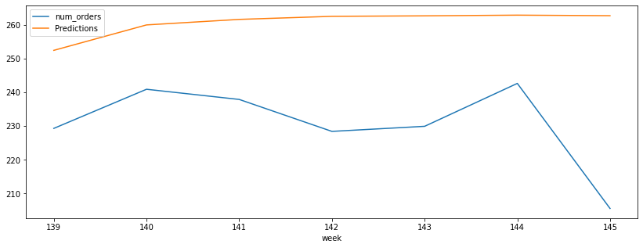
LSTM Model
Model | R² | MAPE
LSTM | -6.86 | 13.31

Slide 17
Interpretation
Note that time series models are aggregated over weeks only, because of which they are losing lot of information, hence MAPE although is less but R2 is also very low.
Hence these time series models aggregated over weeks are consistently giving bad predictions.
We could try to fit the time series models without aggregating over week, that would be very time consuming, and costly to calculate.

Slide 18
Regression Models

Slide 19
Regression Models on weekly aggregated data
Regression Model | R² | MAPE
Feature selection | -271.21 | 845.42
Feature selection and adding all dummy variables | -213.22 | 791.56

Slide 20
Regression Models on unaggregated data
Before fitting the below models applied feature selection by removing highly correlated regressors,
and using 10 week lagged values of orders data
Regression Model | R² | MAPE
Simple Linear Regression | 64 | 1295
Ridge Regression | 64 | 1294.1
Decision Tree Regressor | 68.58 | 1186.341
Random Forest Regressor | 72 | 1126.18

Slide 21
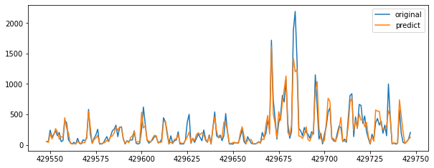
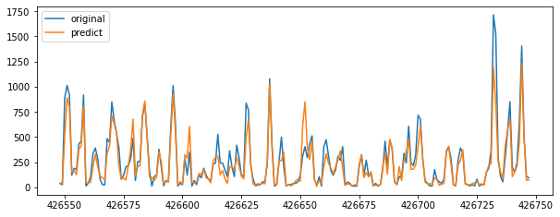
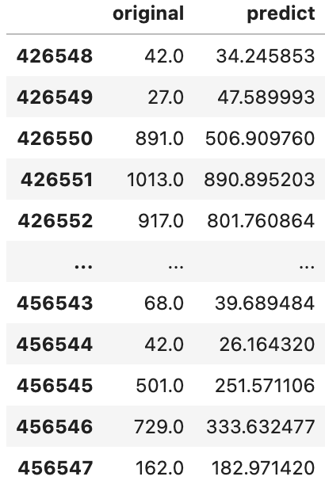
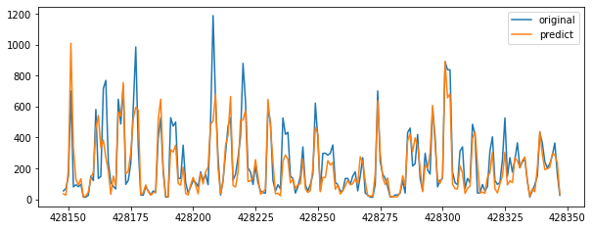
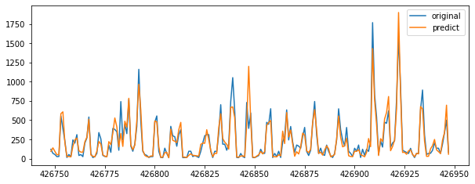
Regression Models on unaggregated data
The MAPE were very high even after feature selection, so taken logarithm for the orders, and prices columns
Regression Model | R² | MAPE
XGB Regressor | 82 | 46
Some visualization and values for XGB Model

Slide 22
More Granular Models

Slide 23
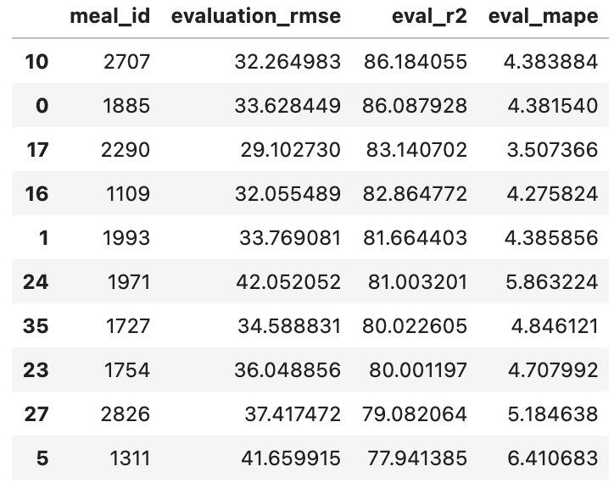
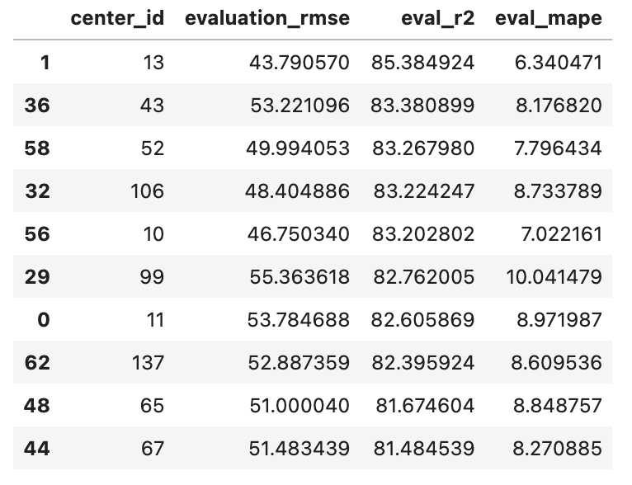
Granular Models
Meal and Center level Models
We fitted the XGB Model in Meal and Center level data to get better results, i.e reducing the MAPE.
Meal Level Performance
Center Level Performance

Slide 24
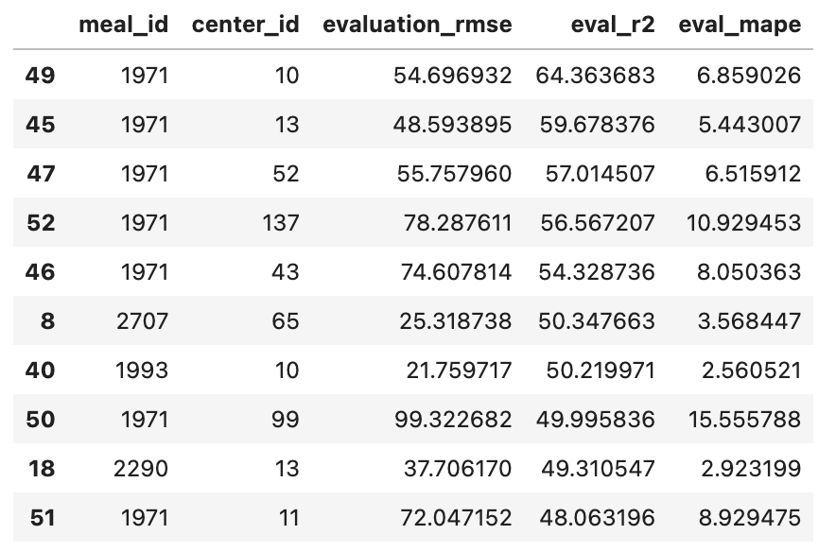
Meal cross Center Level
We fitted the model in 10x10 top meal and centers into total 100 data, and found out that the best meal level models or
best center level models did not perform best in meal cross center level, the R² has reduced significantly.

Slide 25
Results and Prediction

Slide 26
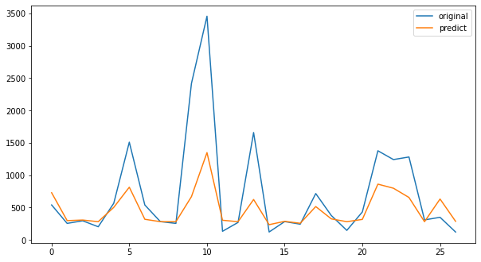
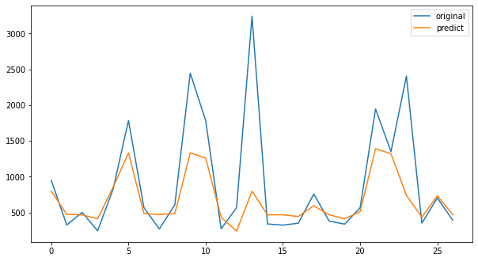
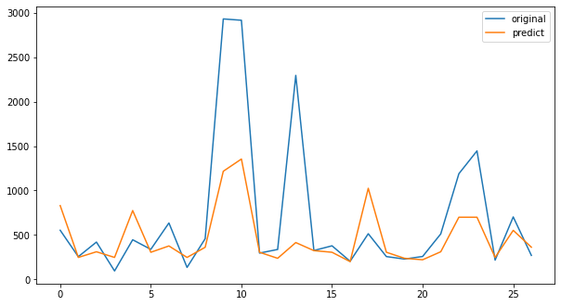
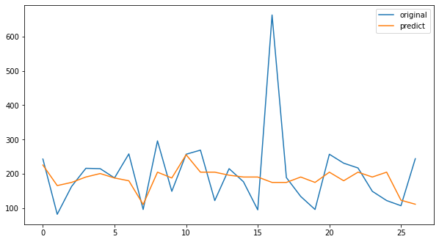
Predictions and Insights
Prediction for meal_id 1970 center id 10
Prediction for meal_id 1970 center id 13
Prediction for meal_id 1970 center id 52
Prediction for meal_id 2760 center id 65

Slide 27
Predictions and Insights
A good feature of these predictions can be seen, that they have predicted the peaks and dips properly
Also, on average predictions are higher than original, but for peaks or special cases the predictions are lower than the original, this insight will help in a way by not storing excessive foods that might perish, in case of special occasions in future did not really have that high demand, thus mitigating the risks.
For the meal cross center data which has not performed better we might have to fit other models

Slide 28
Future Scopes

Slide 29
Future Scopes
Due to the time series models not performing well, and being costly to apply in large datasets, we had to resort to regression models.
Which essentially converted the forecasting problem into prediction problem.
To avoid this, we can try to apply time series model in all data of meal cross center granularity.
Second approach, we have also seen the LSTM model performed moderately, well for a 12-week window of prediction.
We can apply LSTM to all the required regressors to get a forecast (future values) on them.
Then take these future values to predict demand for number of orders in future, using a good regression model, to save time and computation.
Github Link for the project

Slide 30

Thank You! For attending
Email: arkaprova@sigmoidanalytics.com
Offices:
USA: New York, San Francisco, Dallas | Peru: Lima | India: Bengaluru

